Slide 1





OO PRINCIPLES
Notes:
Object relationships

Slide 2
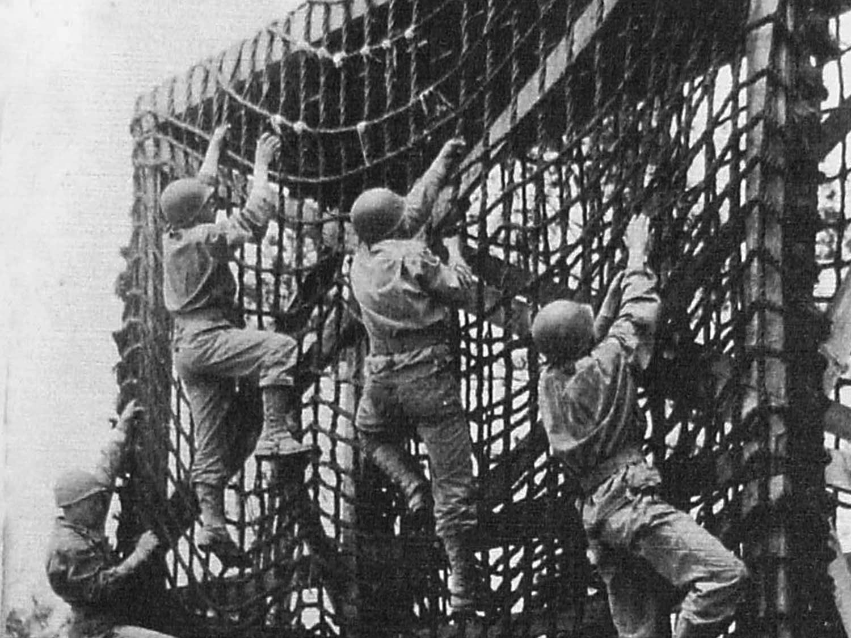
Bootcamp
Notes:
Devs together
5 – 7 days of sessions

Slide 3
70/20/10 Model
Notes:
Socratic Method; Fancy way of saying hands on

Slide 4
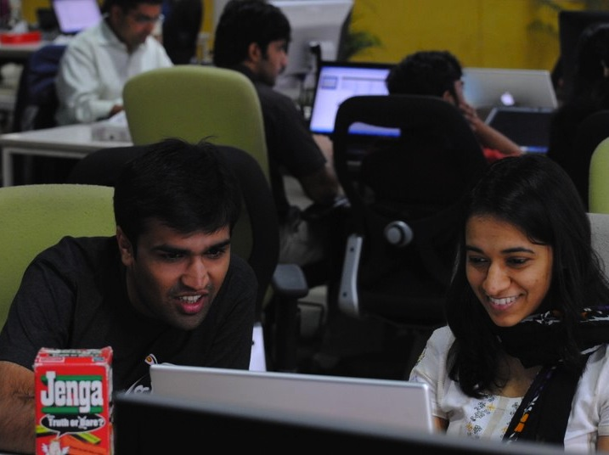
Credit: Pk
Notes:
Pair programming: 2 heads are better than 1

Slide 5
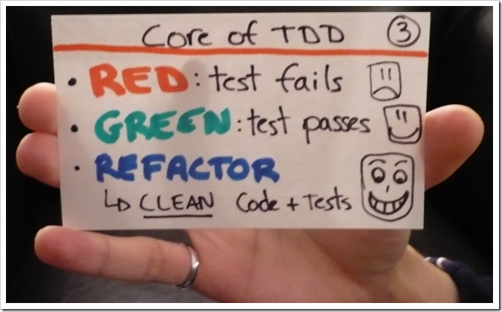
image: doolwind.com

Slide 6


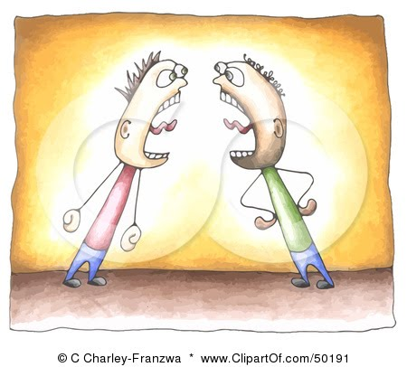

Class Contract
Notes:
Punctuality
No distractions
No email, internet etc.
Respect and wait your turn to speak

Slide 7


Class Contract
Pairing
Not pairing
Notes:
Punctuality
No distractions
No email, internet etc.
Respect and wait your turn to speak

Slide 8

What do customers want
Notes:
Functionality,
Non-Functional behaviour,
Maintainability

Slide 9

Maintainability
Notes:
Why maintainability? (Bad Code is hard to maintain)
- Time/cost to add new features (time to market)
- Time/cost to ﬁx bugs
- Continuity of projects (developer ﬂuctuation)

Slide 10

Clean Code
Notes:
Bad code can function. But it can bring development to its knees.
Design Principles, Patterns, Practices to write clean code

Slide 11
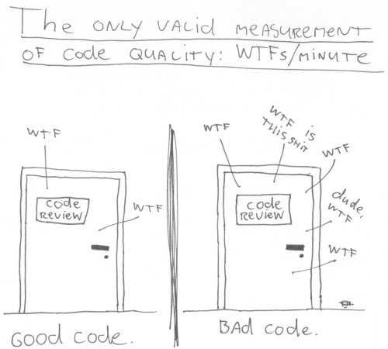
Notes:
- Writing code vs. Reading/Understanding => 1:4

Slide 12

Design
Notes:
OO programming starts with design.
- Agile does not mean no design
Agile means little upfront BUT continuous evolutionary design
- When identifying classes -> Think of Jobs -> Helps clarify your thinking i.t.o. responsibilities - Think what it might encompass and where its boundaries may lie.

Slide 13
The job of a…
Notes:
Lenght/width -> Analogy: Doctors Job. Doctor has a stethoscope, scalpel, heart monitor, etc.
Doesn’t describe Job.
Polygon -> too general (could be parallelogram)
- Methods -> What about when we add more methods? Shouldn’t change job! -> Understands a four-sided ﬁgure with sides at a right angle

Slide 14
The job of a…
• concise
• no “and”
• no recursion
• understands...

Slide 15
S•R•P |Single Responsibility Principle|
A class should have only one
reason to change.
Notes:
SRP gives us: Deﬁnition of responsibility and guideline for class size.
simple to understand. Yet, most often violated.
Why? Many think... - Program works = Job done. Don’t switch to organisation and cleanliness. Move on to next problem instead of breaking overstuffed classes into decoupled units with SR.
Fear: Large number of small (single purpose) classes = difficult to understand big picture = lots of navigation to get big picture
Analogy: Toolbox with many small drawers, well-deﬁned, well-labelled components... or toss...
- Large system: large amount of logic and complexity. Goal: Manage by organising -> ﬁnd - > understand only affected area
- System with large classes -> hampers us -> wade through lots of things / no need right now

Slide 16
D•R•Y |Don’t Repeat Yourself|
D•R•Y |Don’t Repeat Yourself|
D•R•Y |Don’t Repeat Yourself|
Find and eliminate duplication
Whenever you can.
Notes:
DRY and SRP are related. Often appear together.
DRY = Putting piece of functionality in a single place.
SRP = Making sure that a class does only one thing.
Good apps: Classes do one thing and well (SRP) and don’t share that behaviour (DRY)

Slide 17

Notes:
Implement a geometrical rectangle –
Calculate area and perimeter - Use TDD –
What public methods did you deﬁne? -> get/set width/length break encapsulation -> exposes data to external world. Don’t!
- Feature envy Why do we make length/width private? -> Only used in calculation.
Where should area calculation be? -> In rectangle. Behaviour close to data.

Slide 18
Notes:
1960 Fred Brook’s suggested: -
Finding the right data structure is the most important thing. –
Once data structure is deﬁned (circle), code can access it directly (arrows)

Slide 19
Notes:
Issue with previous idea:
change data structure -> change all code -> tight coupling:
data-code - Hide/encapsulate data behind a stable interface (i.e. code)
- Other code is now no longer directly dependent on data

Slide 20
Clean Code
Job of a class
SRP
DRY
Encapsulation
Notes:
Clean code matters -> maintainability
Job of a class -> concise, no “and”, no recursion, “understands”
SRP -> responsibility = reason for a change
Encapsulate data behind behaviour

Slide 21
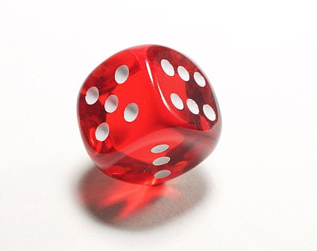
OO PRINCIPLES:
Value Objects
Notes:
Also: Immutable objects. What does this mean? - Class whose instance cannot be modiﬁed
Java Library example: String. - Also, a bit similar to primitive types.
Reason: Easier to design, implement and use than mutable.
- Passed around by value, i.e. don’t care how many 100$ objects I’ve got in my system or if they are actually identical.

Slide 22
“
”
A small simple object, like money or a date range, whose equality isn’t based on identity.
Martin Fowler

Slide 23
“
”
Classes should be immutable unless there's a very good reason to make them mutable.
Joshua Bloch

Slide 24
Value Object Recipe
No mutators
Private ﬁelds
Final class
Final ﬁelds
Exclusive Access to mutable components

Slide 25

Notes:
Coding exercise!Let’s model chance
Flip coin, Roll dice, etc. –
Design is important -> 5 minutes design discussion
Job: Understands likelihood of an event
- Characteristics: Contains value representing a probability
- Constraint: 0 <= probability >=1
- Behaviours: not / and / or

Slide 26
not()
Notes:
Write test for not() - Try to write assert statement ﬁrst - Don’t implement not() yet - 5 minutes (test) + 3 minutes (impl)

Slide 27
equals()

Slide 28
Equivalence Relation
Reﬂexive
Symmetric
Transitive
Consistent

Slide 29
Equals Recipe
Identity check
Null check
Type check
Value check

Slide 30
hashCode()
Notes:
Always override hashcode when overriding equals!

Slide 31
F5
Notes:
Let’s refresh.
public Chance not() {
return new Chance(CERTAINTY - probability);
}
methods return the result of applying a function to their operand without modifying it.
- Contrast this to the more common procedural or imperative approach in which methods apply a procedure to their operand, causing its state to change.

Slide 32
U
P(A && B) = P(A) * P(B)

Slide 33
U
P(A || B) = P(A) + P(B) - P(A) * P(B)

Slide 34
De Morgan’s Law

Slide 35
De Morgan’s Law
P(A || B) = !(!P(A) && !P(B))

Slide 37
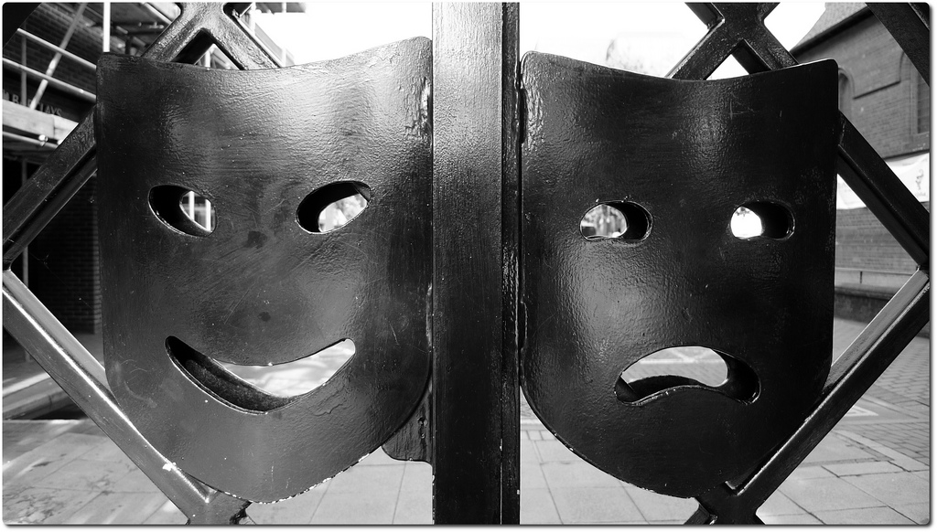
Notes:
Good things about value objects?

Slide 38
Simplicity
Notes:
Exactly one state -> Creation state
- Mutable objects -> Complex state spaces / Many state transitions -> Need docs

Slide 39
Thread-Safety
Notes:
Inherently thread-safe - Require no synchronisation
By far the easiest approach to achieve thread safety
- Can be shared freely - Thus, can reuse instances (e.g. static factory methods)

Slide 40
Share
private static final FIFTY_FIFTY = new Chance(0.5);
public static Chance fiftyFifty() {
return FIFTY_FIFTY;
}
Notes:
Can be shared freely.
Take advantage of this by encouraging clients to reuse existing instances wherever possible.
- Provide static factories that cache frequently used instances

Slide 41
Building Blocks
Notes:
Much easier to maintain a complex object if underlying components will not change
- Also, make great map keys / No worry about keys changing

Slide 42
Notes:
Negative aspects?

Slide 43
Performance
Notes:
Creating many objects can be costly
Very rarely, this will be the bottleneck
- Create mutable companion class (e.g. String and StringBuilder)

